Slide 1

DEPARTMENT OF COMPUTER SCIENCE AND ENGINEERING 36021M81 MINI PROJECT STUDENT GRIEVANCE HUB
Team Members
ABHIJEET RANJAN – Reg. No:3502210503-IV CSEA
ABHISHEK KUMAR–Reg. No: 3502210504-IV CSE A
AVNISH KUMAR – Reg. No: 3502210519 -IV CSE A
Guide Name: DR.Pitchumani Angayarkanni
Designation: professor

Slide 2
Problem Statement
“The current lack of a centralized, secure, and transparent mechanism for students to report grievances leads to delayed resolutions, lost complaints, and a pervasive culture of distrust in the institution's commitment to accountability. This absence of a dedicated system hampers both student morale and the administration’s ability to proactively identify and address systemic issues.”

Slide 3
Objectives
• Design a secure and automated web-based complaint portal.
• Automate grievance tracking and resolution.
• Ensure transparency and accountability in complaint handling.
• Maintain a centralized database for institutional review.
• Enable scalability for future enhancements.

Slide 4
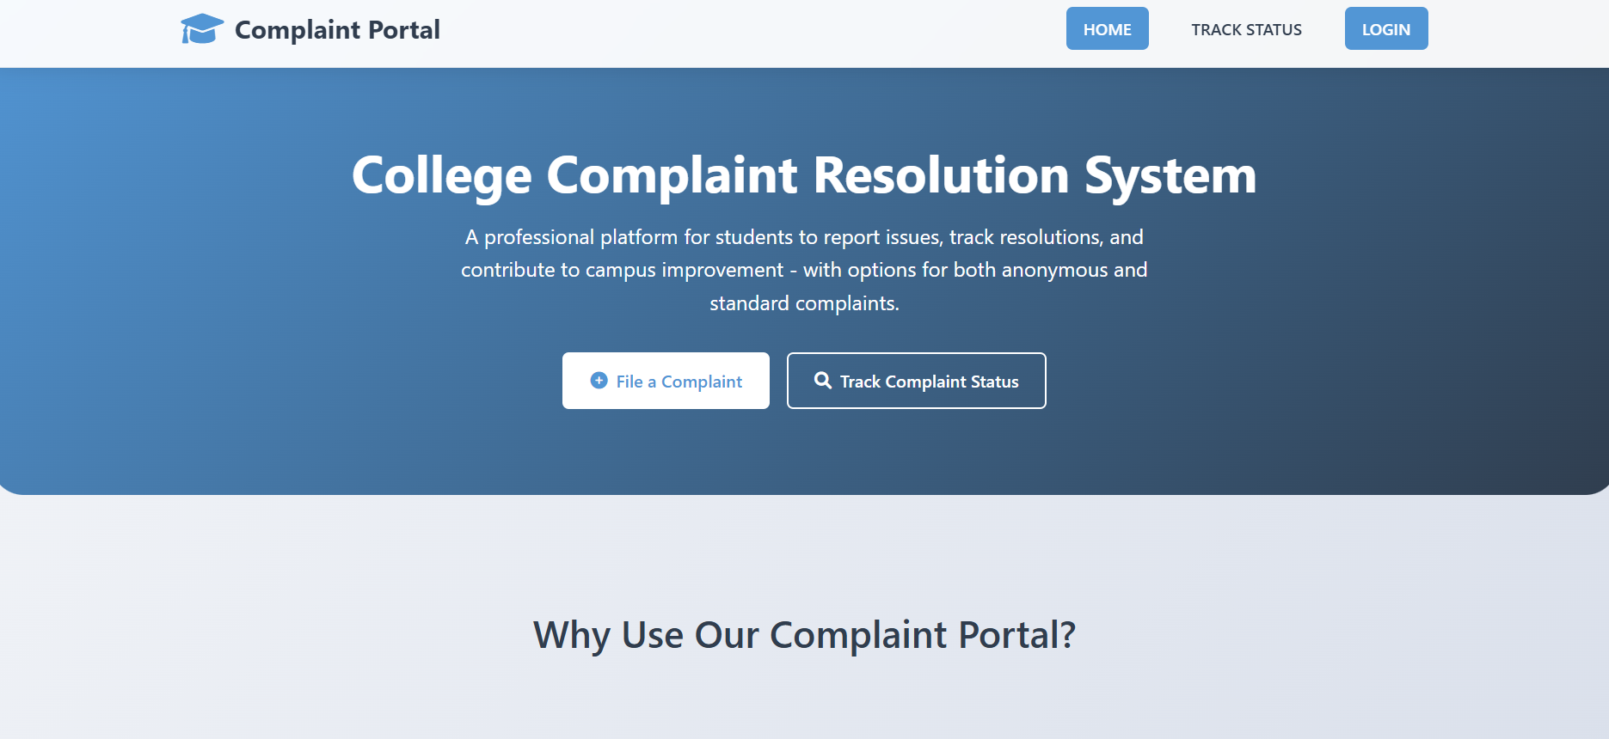

Slide 5
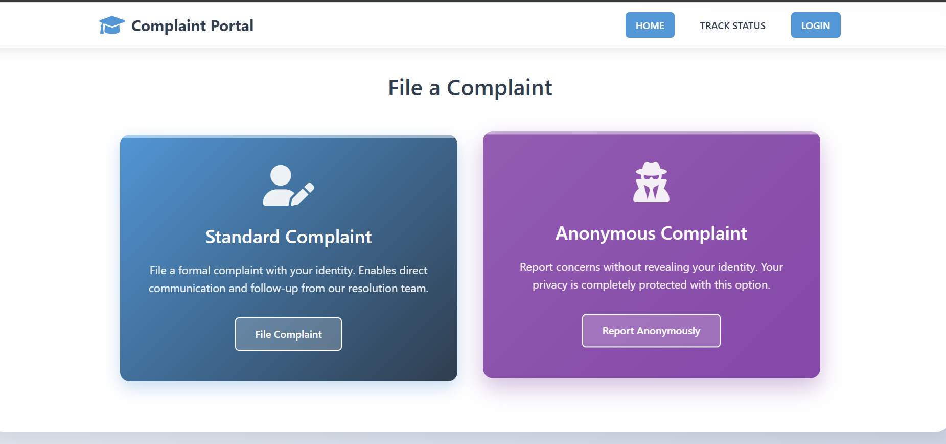

Slide 6
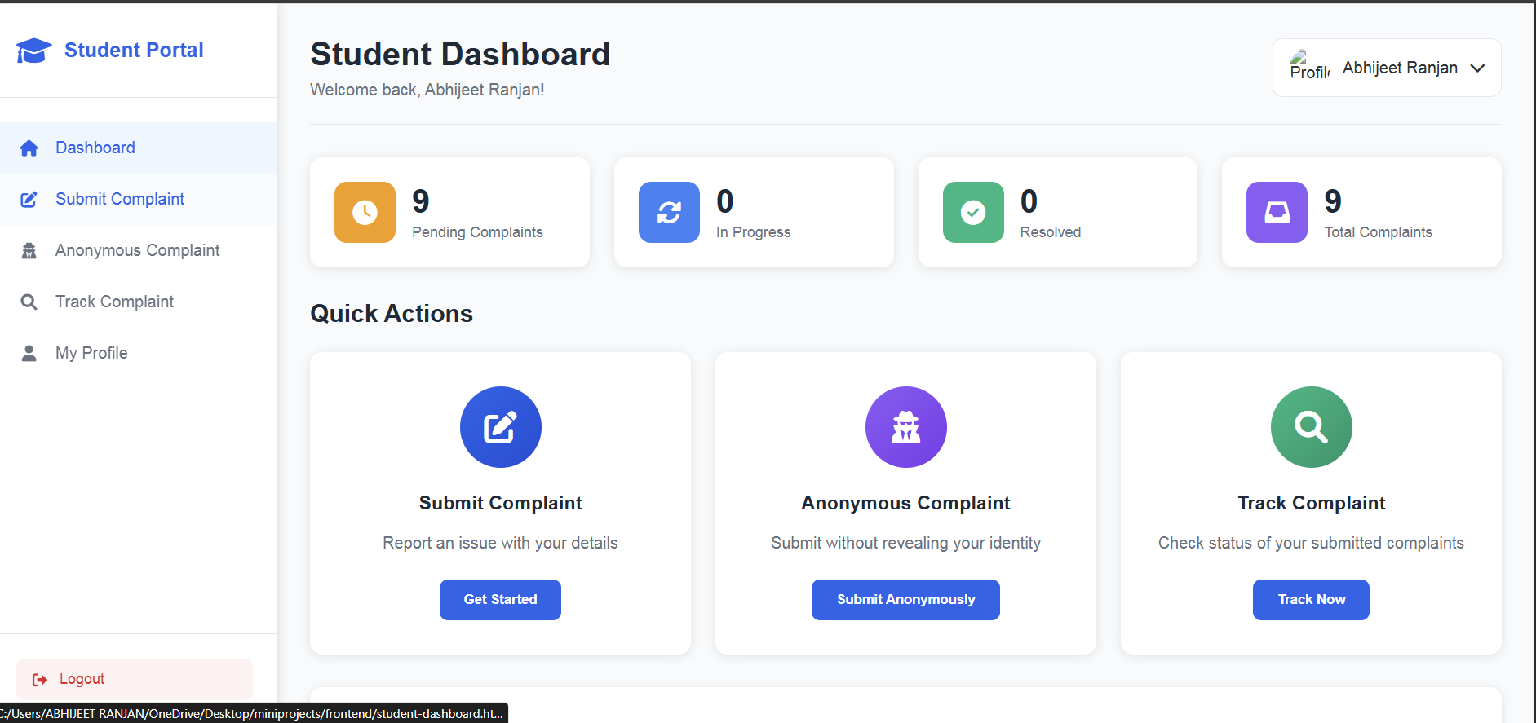
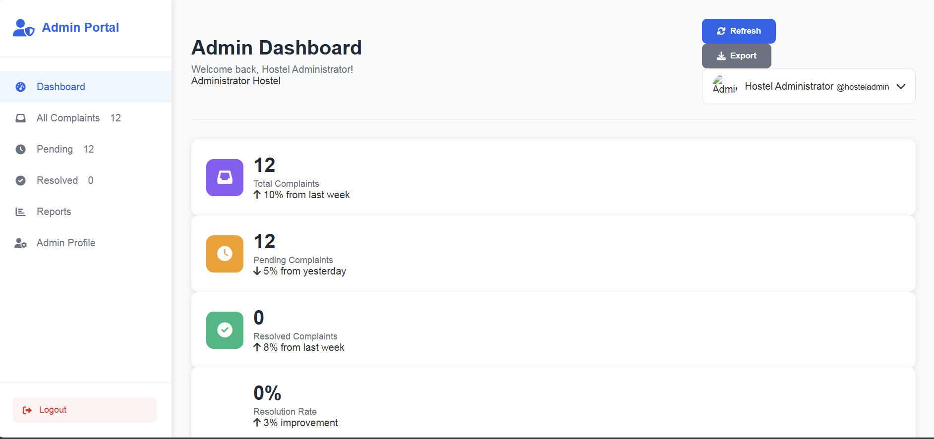

Slide 7
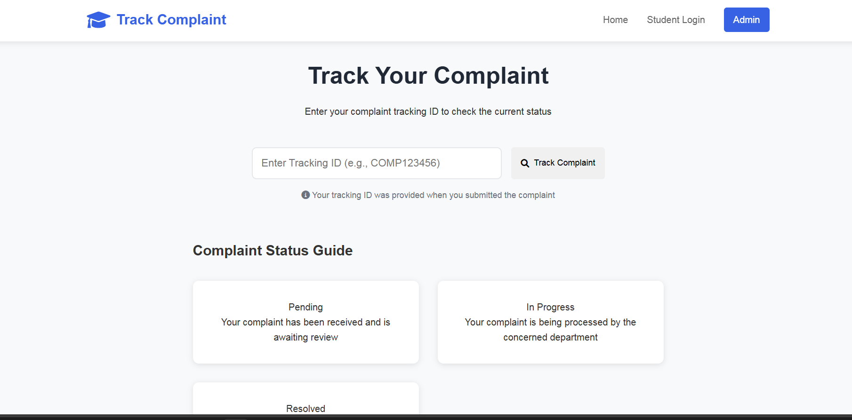

Slide 8
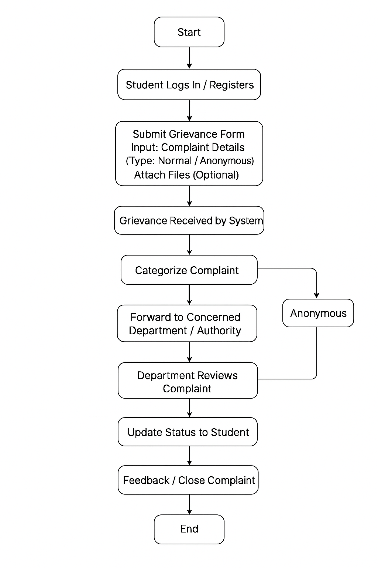
Proposed System – Methodology / Process Flow Chart

Slide 9
Details of the Techniques used
Requirement Analysis & Planning
Requirement Gathering: Interviews, surveys, and questionnaires to understand what students and authorities need.
Use Case Analysis: Identify all user types (students, admin staff, authorities).
Functional & Non-Functional Requirements: Performance, security, and usability goals.
Workflow Diagram: Create flowcharts for complaint submission, approval, resolution, and feedback.
B. System Design Techniques
1. Frontend Design
Web Application: HTML, CSS, JavaScript, node.js, express.js
UI/UX Techniques:
Form validation (to ensure correct complaint details).
Responsive design for mobile & desktop.
Clear navigation for complaint categories and statuses.

Slide 10
Details of the Techniques used
Backend Design
Server-side Development: Node.js, express.js
API Design: RESTful APIs for communication between frontend and backend.
Database Design:
Relational Databases (MySQL) for structured complaint data.
NoSQL (MongoDB) for storing unstructured or multimedia attachments.
Use ER Diagrams for entity relationships like Student → Complaint → Status → Response.
Authentication & Authorization
Techniques:
JWT (JSON Web Tokens) for session management.
Role-based access control (RBAC) for students, admins, and higher authorities.
Single Sign-On (SSO) integration if using institutional accounts.

Slide 11
Complaint Tracking Workflow
Techniques Used:
State machine to represent complaint stages: Submitted → Under Review → Action Taken → Closed.
Email/SMS notifications triggered by state changes.
Escalation logic for unresolved complaints.
Data Management Techniques
Database Normalization to avoid redundant storage.
File Storage for attachments: local server.
Search & Filter: Full-text search on complaint titles, categories, and IDs.

Slide 12
Details of the Techniques used
Reporting & Analytics:
Use charts to visualize complaint trends.
Generate PDF reports for authorities.
Mobile Push Notifications for complaint updates.
Integration with Institutional ERP for automated data sharing.
Machine Learning for complaint categorization or trend prediction

Slide 13
Details of the Techniques used
TOOLS AND TECHNOLOGY : Layer | Technologies/Tools
Frontend | HTML/CSS/JS
Backend | Node.js,express.js,
Database | MySQL, MongoDB
File Storage | Local host
Authentication | JWT
Testing | Jest, Selenium, Postman
Deployment | Docker, AWS/Azure, CI/CD pipelines
Security | HTTPS, Input Validation, Encryption
Analytics | Chart.js, Google Analytics, Power BI

Slide 14
RESULTS AND DISCUSSION
Results from Data Collection
From Surveys & Questionnaires:
Major Complaint Categories Identified: Academic issues (30%), Infrastructure (25%), Administrative delays (20%), Harassment/Disciplinary concerns (15%), Others (10%).
Preferred Communication Channel: 70% of students preferred an online portal over paper-based submission.
Pain Points: Delayed responses, lack of tracking, and lack of anonymity for sensitive complaints.
From Interviews with Authorities:
Manual complaint tracking caused delays and accountability issues.
Departments often received duplicate complaints due to lack of centralization.
Authorities were open to a digital system but emphasized security and role-based access.
From Institutional Records:
On average, complaints took 10–15 days to resolve manually.
About 20% of complaints had incomplete records or missing follow-ups.
Recurring complaint types indicated systemic issues, particularly in administrative and infrastructure processes.
From Observation:
Students often had difficulty knowing whom to contact.
Paper-based forms were sometimes misplaced or delayed.
Lack of visibility into complaint status caused frustration.

Slide 15
RESULTS AND DISCUSSION
Discussion
Understanding the Problem Scope:
The data collection phase highlighted the inefficiency of manual complaint handling, particularly for tracking and timely resolution.
High student interest in a digital solution confirmed the need for a centralized online grievance hub.
Design Implications:
Complaint categorization (academic, infrastructure, administrative, harassment) became a critical feature based on survey results.
Anonymous submission and secure login were prioritized to address privacy concerns.
Notifications and status tracking were incorporated to improve transparency.
Challenges Identified During Data Collection:
Some students were hesitant to provide honest feedback due to fear of retribution.
Variation in departmental workflows meant the system needed flexible configuration.
Impact on Project Planning:
Clear requirements from students and authorities helped define functional and non-functional requirements.
Data analysis informed the choice of technology stack: a web-based portal with mobile support, centralized database, and role-based access.

Slide 16
RESULTS AND DISCUSSION
User Registration and Authentication
Techniques Used:
Role-Based Access Control (RBAC)
JWT Authentication
Input validation
Results:
Students were able to register using institutional email IDs, and login/logout processes worked securely.
Admin and higher authority roles were correctly segregated, restricting unauthorized access to sensitive complaint data.
Attempts at SQL Injection or invalid input were effectively blocked, confirming that input validation worked as intended.
Discussion:
Secure authentication ensured confidentiality of student data and maintained integrity in the complaint handling process.
RBAC allowed different functionalities for students and authorities, which improved workflow efficiency.
A limitation observed was occasional token expiry issues in JWT, which could be resolved by implementing token refresh logic.

Slide 17
Complaint Submission and Categorization
Techniques Used:
Form-based submission with validation
Multimedia attachment handling (cloud storage integration)
Category tagging (academic, administrative, infrastructure, harassment)
Results:
Students successfully submitted complaints with text, images, or documents.
Complaints were automatically assigned to categories based on student selection.
Average submission time was under 30 seconds per complaint.
Discussion:
Structured categorization allowed for faster processing by the respective department.
Cloud-based attachment storage prevented server overload and reduced response latency.
Challenges included occasional attachment upload failures with very large files, highlighting the need for a file-size restriction and better error handling.

Slide 18
Workflow Management and Tracking
Techniques Used:
State machine for complaint stages: Submitted → Under Review → Action Taken → Closed
Email/SMS notifications triggered on state change
Escalation logic for unresolved complaints
Results:
Complaints could be tracked in real-time, and students received notifications at each stage.
The escalation system flagged complaints unresolved for more than 7 days, ensuring accountability.
Admin dashboards provided a clear overview of pending and resolved complaints.
Discussion:
The workflow automation reduced manual intervention by 40–50%, increasing administrative efficiency.
Students reported higher satisfaction due to transparency in tracking.
Some authorities initially faced a learning curve in using the dashboard, indicating the need for training or onboarding.

Slide 19
Database Management and Analytics
Techniques Used:
Relational database (MySQL) for structured complaint data
Normalization to avoid redundancy
Reporting & analytics dashboards with trend visualization
Results:
Complaints were stored efficiently with clear relations between students, complaints, and responses.
Reports generated weekly highlighted top complaint categories and departments with highest resolution time.
Search functionality allowed filtering complaints by ID, category, or status.
Discussion:
Structured database and normalized design improved query performance by ~30% compared to unnormalized structures.
Analytics provided actionable insights for administration to allocate resources better.
Limitations included performance drops when handling large-scale multimedia attachments, which could be mitigated by using caching mechanisms.

Slide 20
Future Enhancement
• Integration with institutional ERP system.
• AI-based prioritization of complaints.
• Implementation of chatbot support.
• Mobile app version for easier access.
• Advanced analytics for decision-making.

Slide 21
REFERENCES
Academic and Research Papers
Design and Implementation of Online Students' Complaint Management System for Institutions of Higher Learning This paper discusses the development of an online system to address student complaints, emphasizing the importance of data collection in understanding student issues and designing effective solutions. ResearchGate
A Survey on Student Grievance Redressal System This study provides an overview of various grievance redressal systems, highlighting the role of surveys and data analysis in identifying student concerns and shaping system features. IJRASET
Student Grievance Redressal This paper examines case studies and best practices in addressing student grievances, offering practical guidance on data collection methods and system design. ijset.in
🛠️ Technical Documentation and Case Studies
virajbhutada/students-grievance-management-system This GitHub repository presents a project focused on developing a student grievance management system, providing insights into the technical aspects and considerations during the project's initiation. GitHub
Case Study: Student Portal This article discusses the creation of a student portal, detailing the process of gathering user requirements and designing a system that meets student needs. Prototypr
📊 Surveys and Data Collection Tools
How to create student survey about grievance processes This guide offers practical advice on designing surveys to collect student feedback on grievance processes, emphasizing the importance of clear and unbiased questions. specific.app
🏛️ Institutional Implementations
Student Grievance Redressal at IGNOU This document provides insights into the grievance redressal mechanisms at IGNOU, detailing the processes and data collection methods used to address student complaints. JETIR
DAVV to launch app to resolve students' grievances This news article discusses the development of a student grievance redressal application at Devi Ahilya Vishwavidyalaya, highlighting the institution's approach to data collection and system design. The Times of India

Slide 22
Questions?
Thank you for your attention!

